Slide 1
Team 82 – Community82 Release 2 Overview (Sprints 3 and 4)
Team Members:
Tess Nash, Kris Kingston, Peipei Zhang, Ji Young Choi, Se Jun Ahn, Kent Lie and Sahib Onkar Singh
Website Link:
http://54.206.25.253/pages/index.php

Slide 2
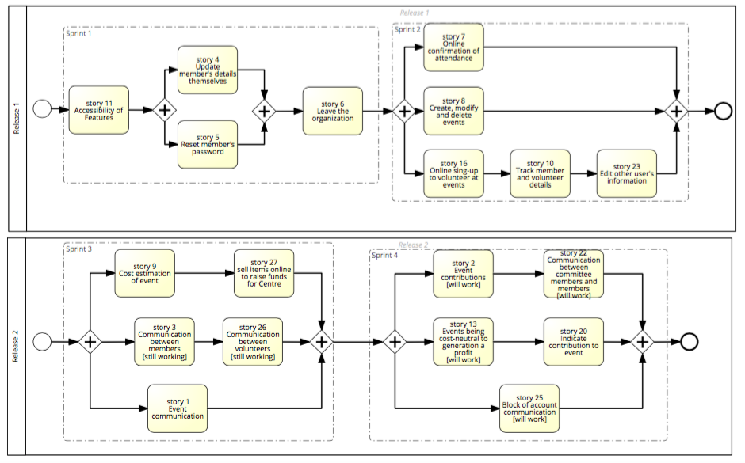
Procedure of All Sprints – BPMN Model

Slide 3
Release 2 Overview: Expectations
What we wanted to achieve at the end of Release 2:
Sprint 3 – 29 Story Points:
Had 5 Stories that we wanted to have completed at the end of the Sprint
Aimed to have all of these stories completed so we could move onto the next sprint
Sprint 4 – 20 Story Points:
Had 5 Stories that we wanted to have completed at the end of the Sprint
Aimed to have all of these stories completed so we could move onto the next sprint and the next Release

Slide 4
Release 2 Overview: Actuals
What we actually achieved at the end of Release 2:
Sprint 3:
Achieved 5 out of 5 Stories (29 Story Points Completed)
At the end of this Sprint, there were two stories that were yet to be classified as fully complete, with only one or two tasks that still needed to be finalised
This was rectified before work began on Sprint 4 stories, with all stories then only minor errors or issues (85% completion rate)
Sprint 4:
Achieved 5 out of 5 Stories (20 Points Completed)
At the conclusion of this Sprint, all stories were declared to be completed
Minor errors and bugs are still present within some of the stories, however the relevant acceptance tests have been run on these stories and they have received a 85% + completion rate as a result of these tests

Slide 5
Sprint 3 – Ideal Task Progression
User Story ID and Description | Story Points | No. of Tasks Involved | Estimated Time Taken (Hours)
S01: Event Communication | 1 | 3 | 3
S03: Communication Between Members | 4 | 4 | 5
S09: Cost Estimation of Event | 4 | 4 | 9
S26: Communication Between Volunteers | 4 | 3 | 9
S27: Selling Items Online to Raise Funds for Centre | 16 | 4 | 17

Slide 6
Sprint 3 – Actual Task Progression
User Story ID and Description | Story Points | No. of Tasks Involved | Actual Time Taken (Hours)
S01: Event Communication | 1 | 3 | 4
S03: Communication Between Members | 4 | 4 | 7
S09: Cost Estimation of Event | 4 | 4 | 12
S26: Communication Between Volunteers | 4 | 3 | 10
S27: Selling Items Online to Raise Funds for Centre | 16 | 4 | 17
NOTE: Some tasks were experiencing errors with execution, however we can still class these tasks as being completed with a 85% completion rate (stories highlighted are now classified as complete, however were experiencing issues with bugs in the system which meant they needed to be fixed before Sprint 4)

Slide 7
Sprint 4 – Ideal Task Progression
User Story ID and Description | Story Points | No. of Tasks Involved | Estimated Time Taken (Hours)
S02: Event Contributions | 2 | 3 | 4
S13: Events Being Cost-Neutral or Generating a Profit | 4 | 3 | 6
S20: Indicating Contribution to Event | 4 | 3 | 5
S22: Communication Between Committee Members and Members | 2 | 4 | 4
S25: Blocking of Account Communication | 8 | 4 | 10

Slide 8
Sprint 4 – Actual Task Progression
User Story ID and Description | Story Points | No. of Tasks Involved | Estimated Time Taken (Hours)
S02: Event Contributions | 2 | 3 | 4
S13: Events Being Cost-Neutral or Generating a Profit | 4 | 3 | 7
S20: Indicating Contribution to Event | 4 | 3 | 8
S22: Communication Between Committee Members and Members | 2 | 4 | 10
S25: Blocking of Account Communication | 8 | 4 | 12
NOTE: Some tasks were experiencing errors with execution, however we can still class these tasks as being completed with a 85% completion rate for stories (story highlighted is classified as complete, but is experiencing issues with bugs in the system which is causing certain aspects to not work as expected)

Slide 9
Sprint 3 Burndown Chart

Slide 10
Sprint 4 Burndown Chart

Slide 11
Release 2 Burndown Chart

Slide 12
Goals for the Next Releases: Releases 3 and 4
Complete the User Stories we have allocated to Release 3 and Release 4
Release 3:
One Feature Title to be addressed in this Release
Notifications
Total Story Points – 18
Release 4:
Two Feature Titles to be addressed in this Release
Promotion and Public Image
Award Nomination Techniques
Total Story Points – 22

Slide 13
Goals for Release 3: Stories to be Completed
User Story ID and Description | Story Points
S15: View Upcoming Events | 8
S17: Notification of Changes to Events | 4
S18: Viewing Total Number of Events Volunteered for | 2
S19: Events Calendar to View Past, Present and Future Events | 2
S21: Notification of Upcoming Meetings | 2
TOTAL STORY POINTS: | 18

Slide 14
Goals for Release 4: Stories to be Completed
User Story ID and Description | Story Points
S12: Consistency of Website with Brand/Image | 1
S14: Attracting Volunteers | 4
S24: Mobile Friendly Website | 1
S28: Nomination of Committee Members and Volunteers for Awards | 4
S29: Nomination for Awards by Committee Members and Volunteers | 8
S30: Map Indication on Website of Upcoming Event Locations | 4
TOTAL STORY POINTS: | 22

